Slide 1
Customer Churn Analysis
An in-depth analysis of customer churn based on various demographic and financial attributes.
Presented by: Bhakti Palkar
Suraj Salunkhe
Vrushali More
Amla Natu

Slide 2
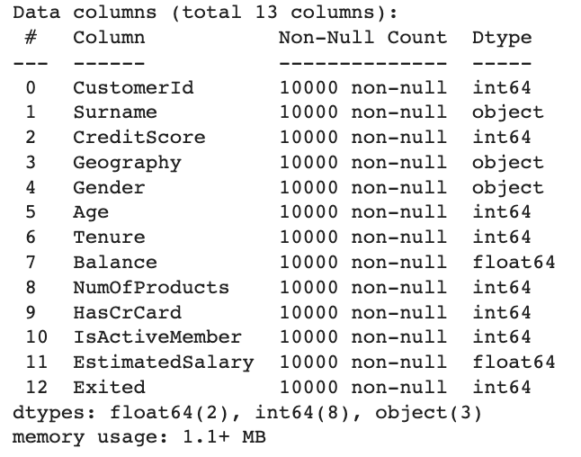
Dataset Introduction
The dataset is related to customer churn, containing various attributes such as demographic information, account details, and whether the customer has exited (churned) or not.

Slide 3
Problem Statement
Addressing Customer Churn: Creating an Advanced Predictive Model to Forecast and Mitigate Potential Customer Loss in a bank using machine learning

Slide 4
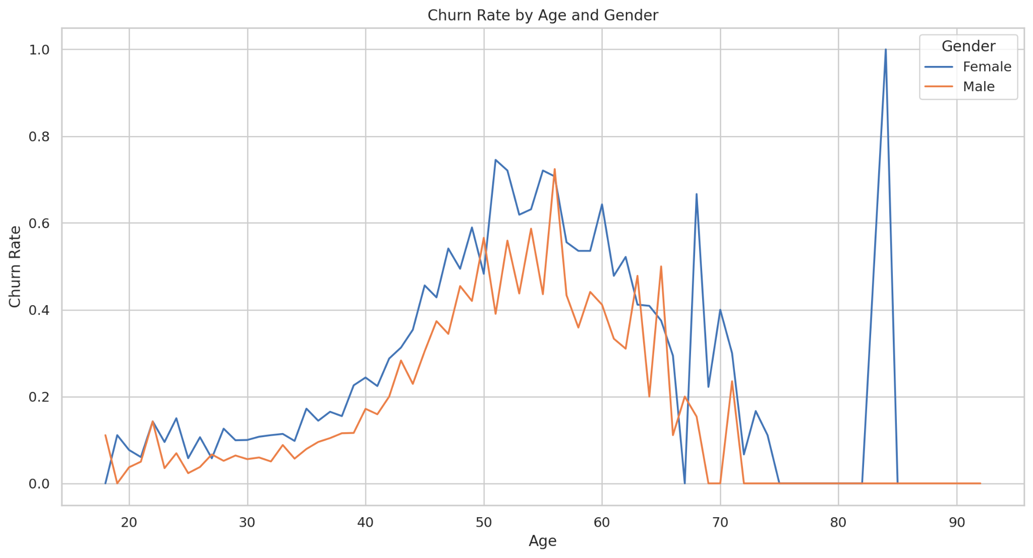
Churn rate by Age and Gender

Slide 5
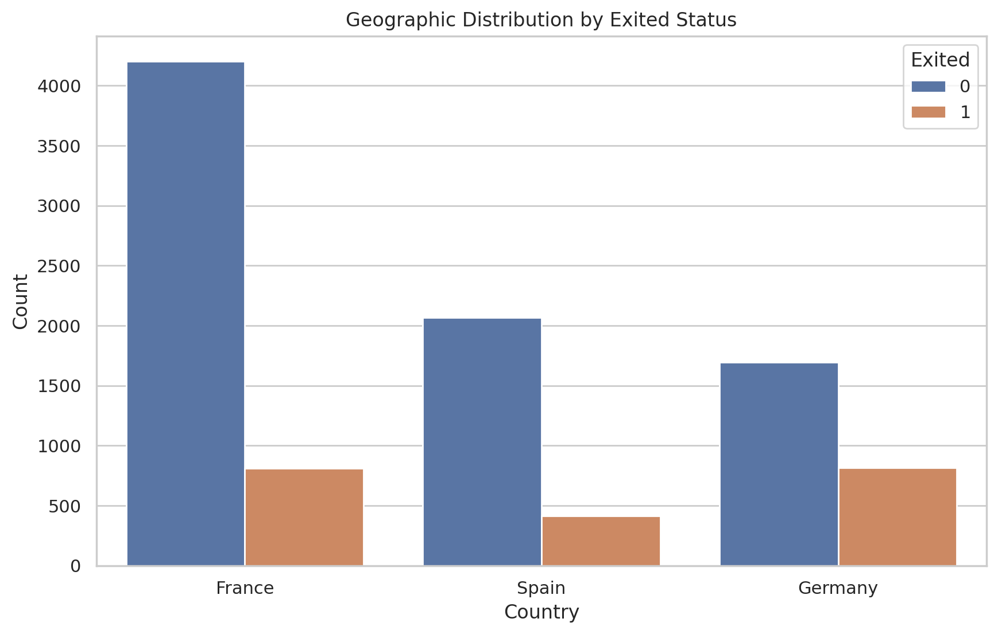
Geographic Distribution by Exited Customers

Slide 6
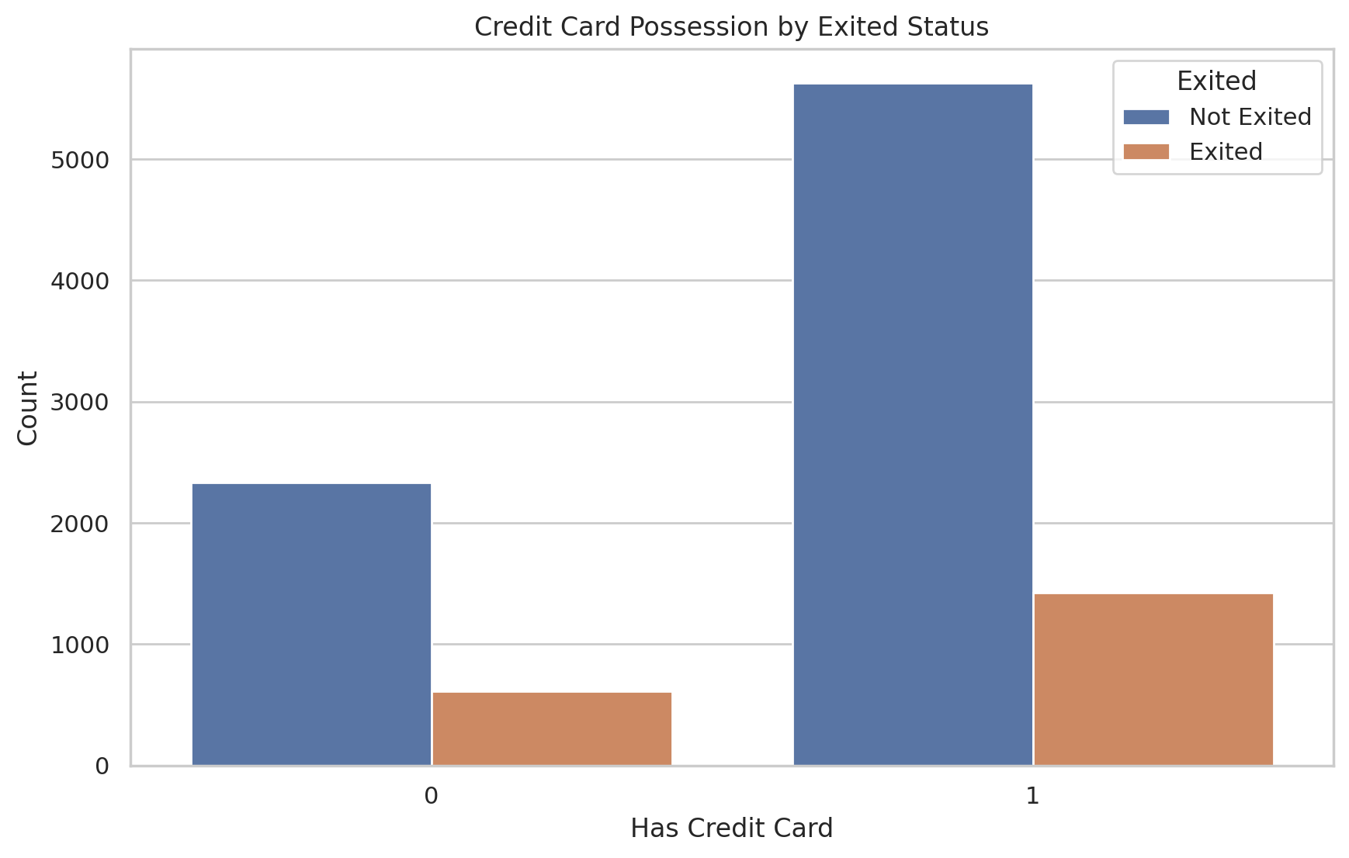
Credit card Possession by Exited Status

Slide 7
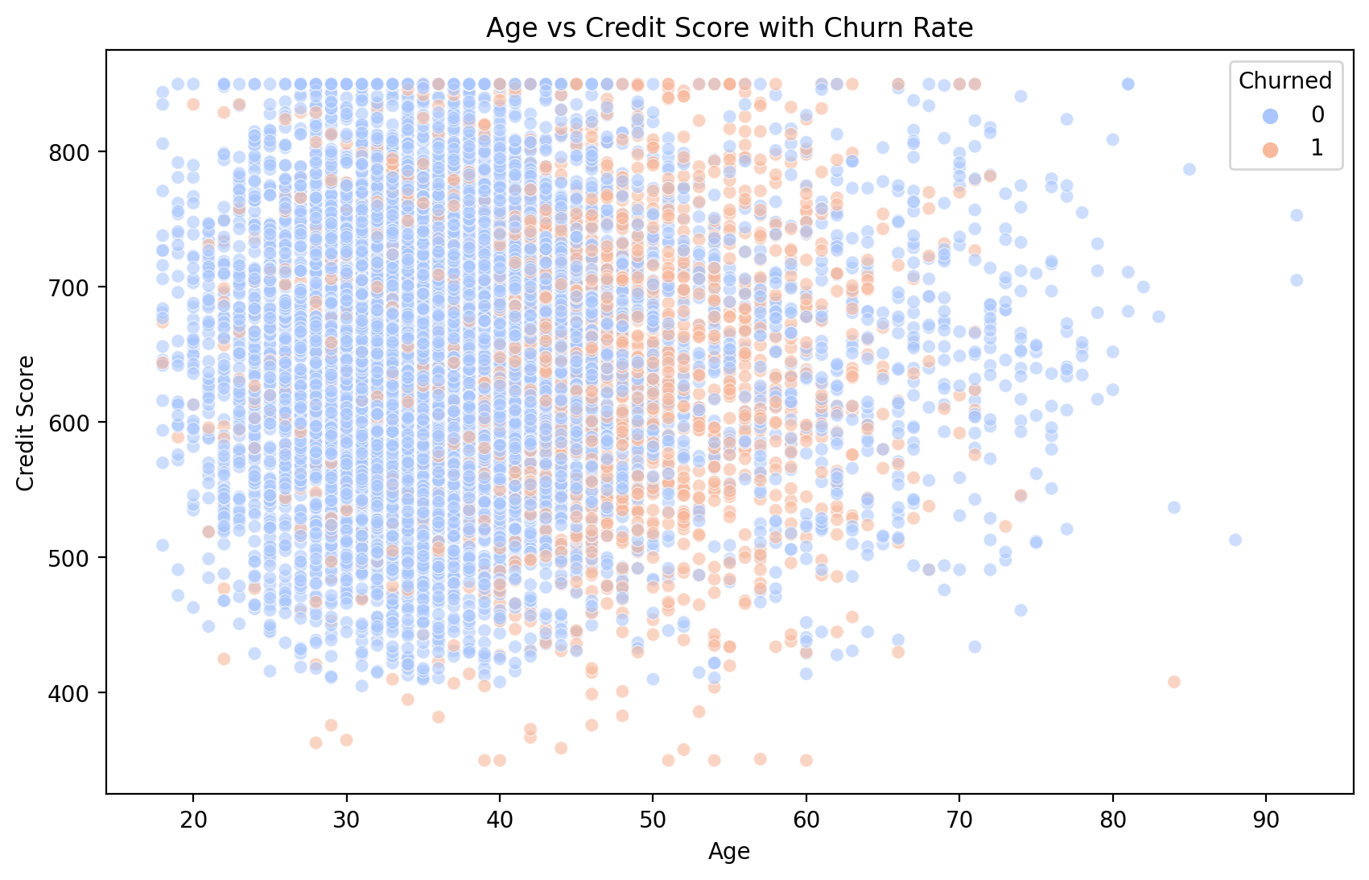
Age vs credit Score with churn Rate

Slide 8
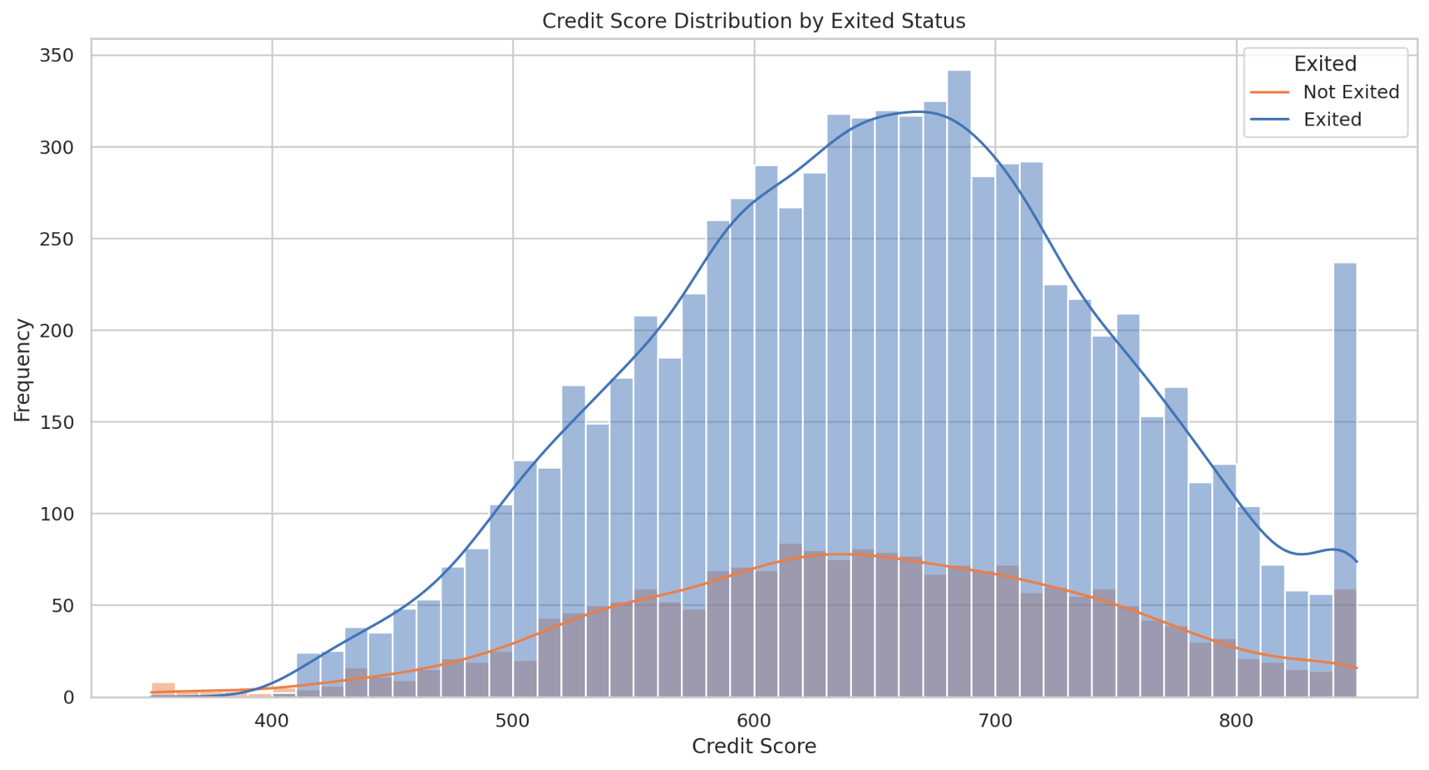
Credit Score Distribution by Exited Status

Slide 9
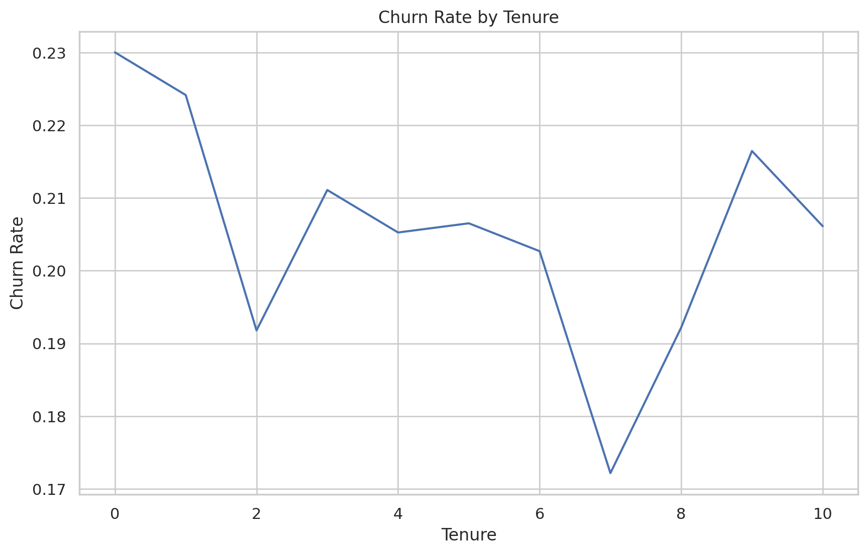
Churn rate by Tenure

Slide 10
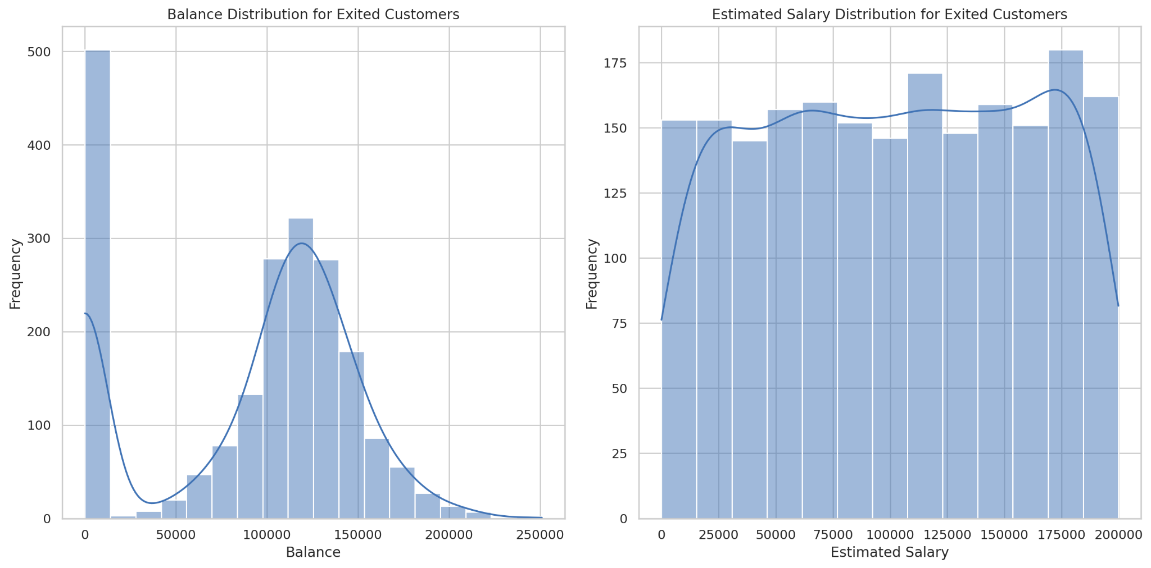
Churn rate by Balance and Salary

Slide 11
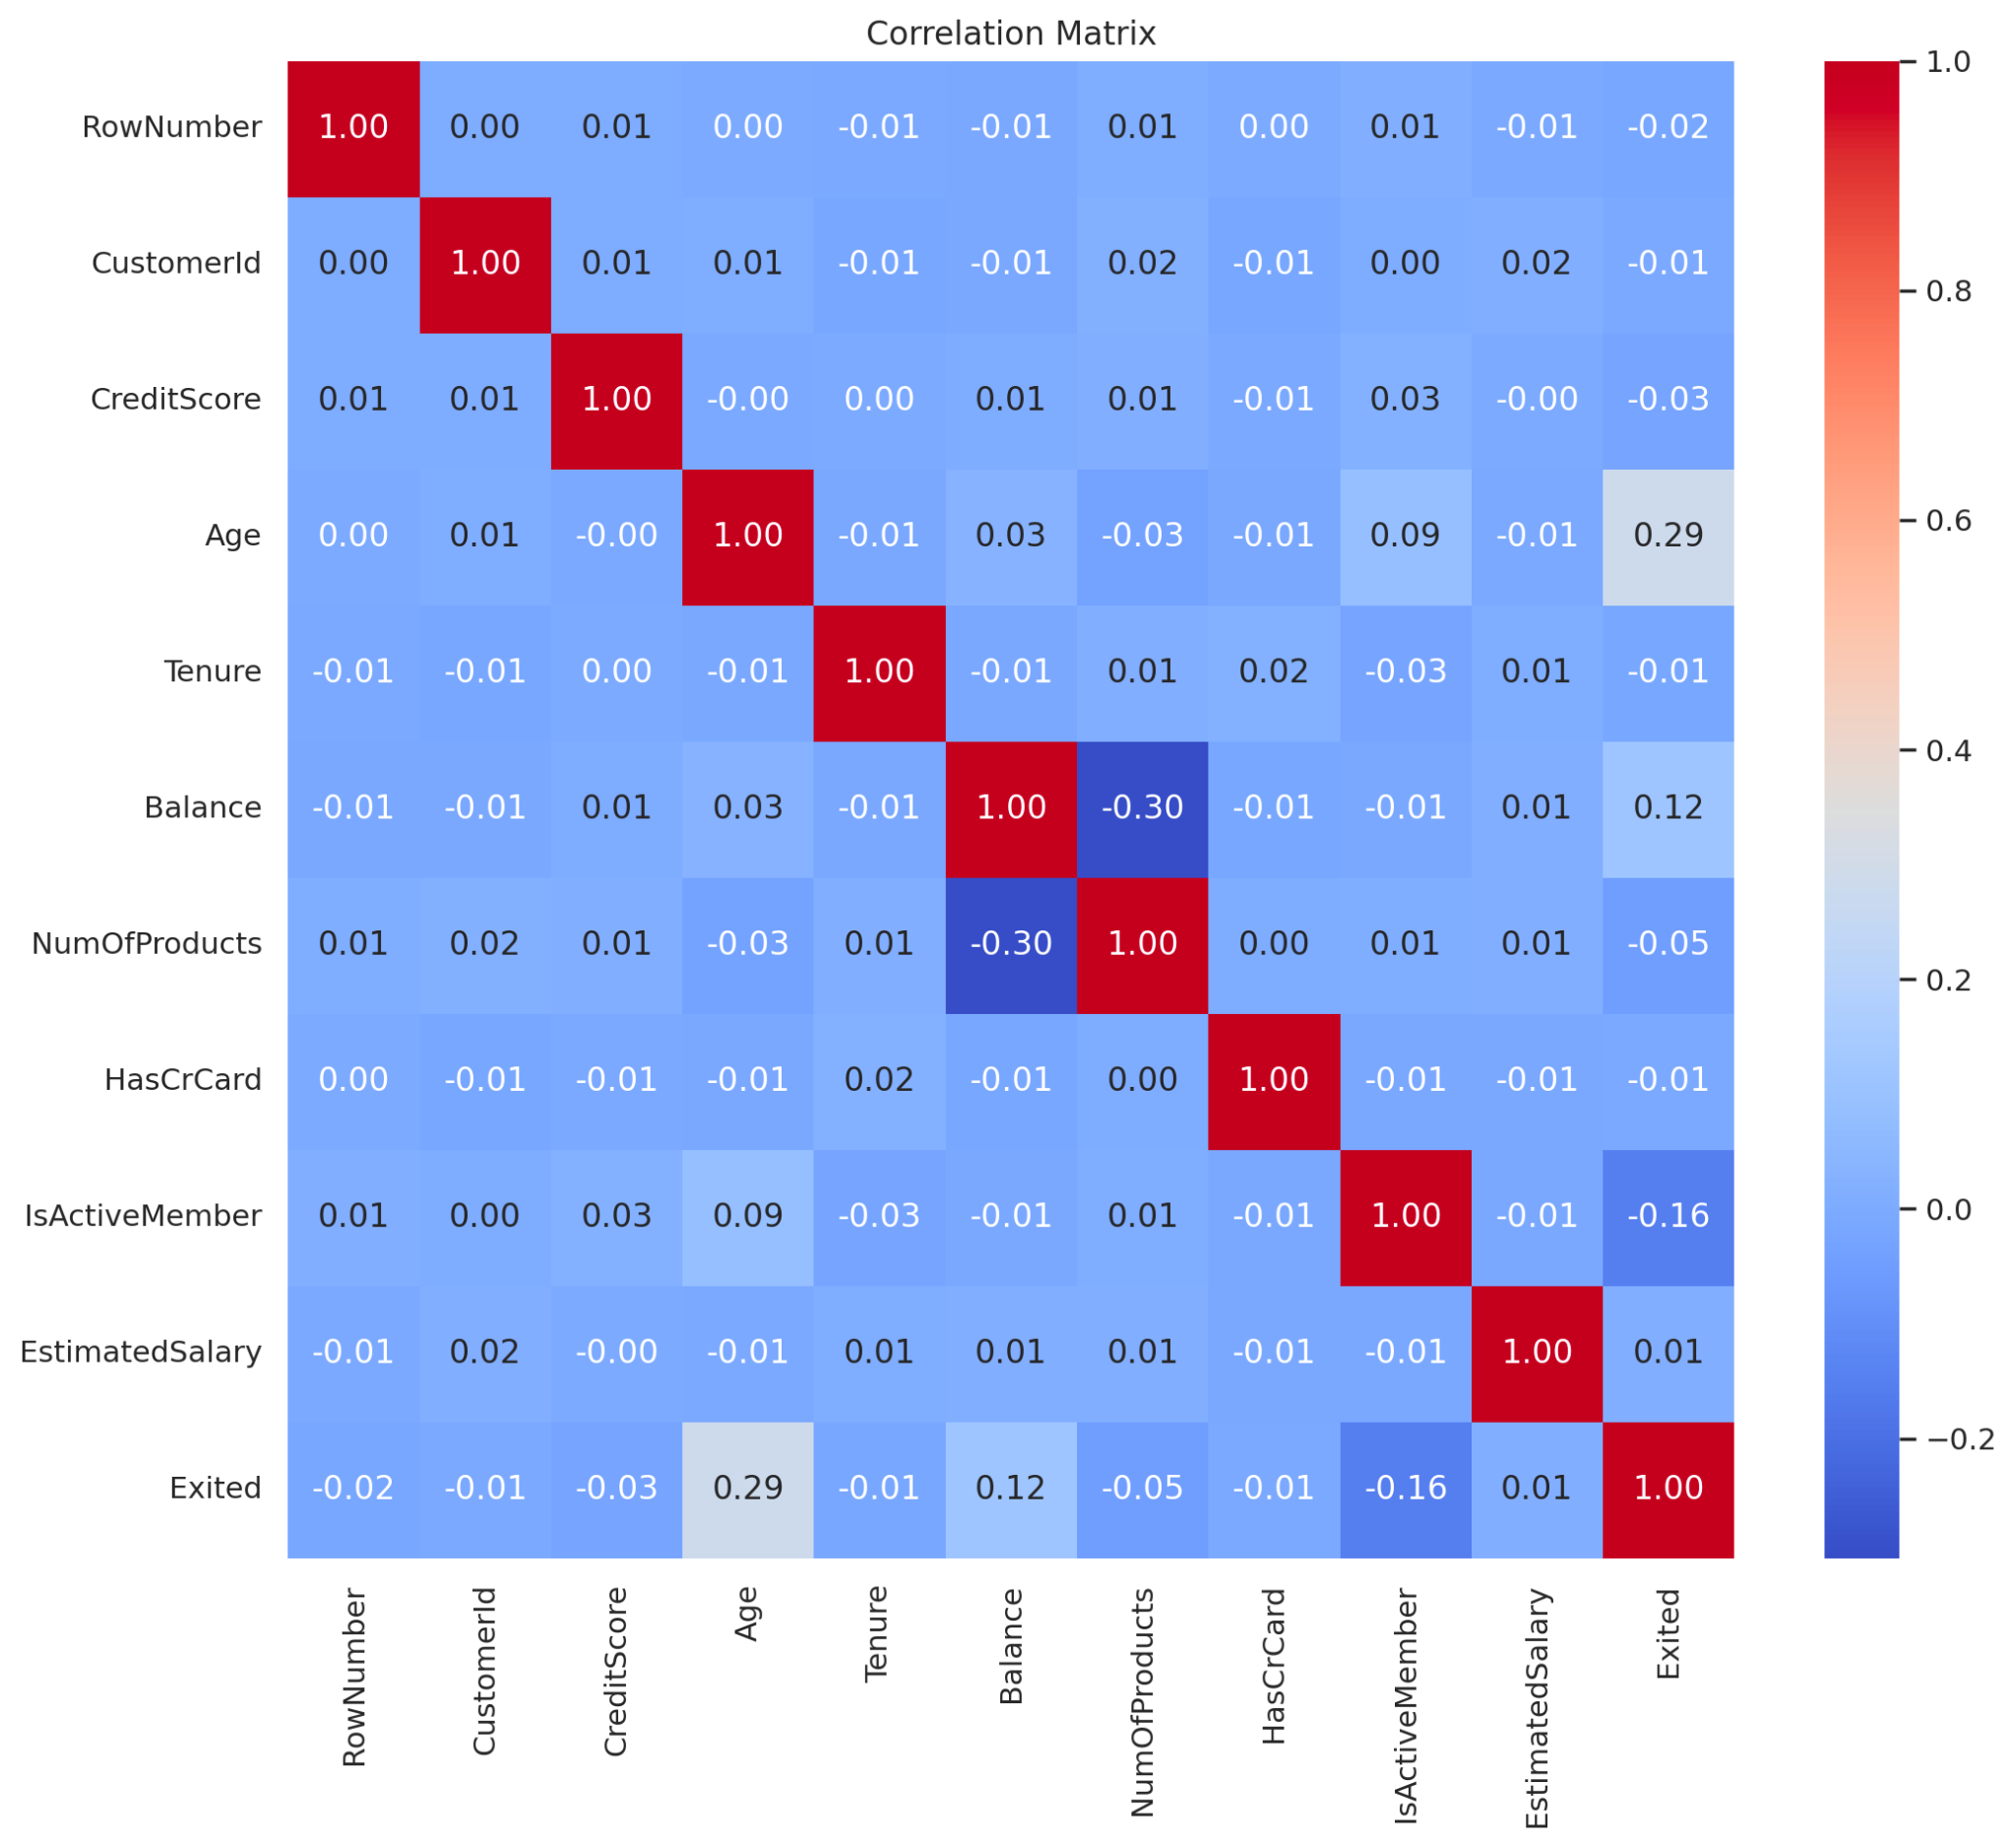
Correlation Matrix

Slide 12
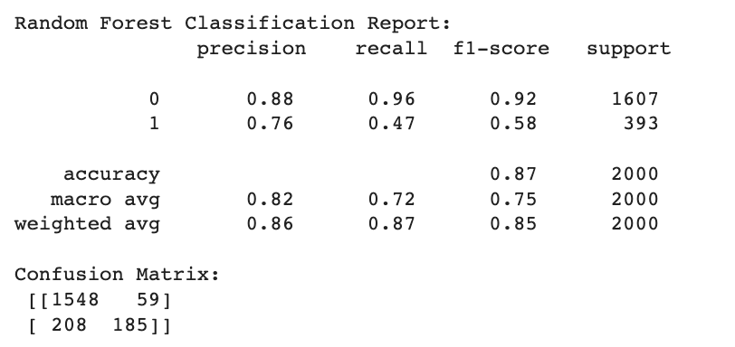
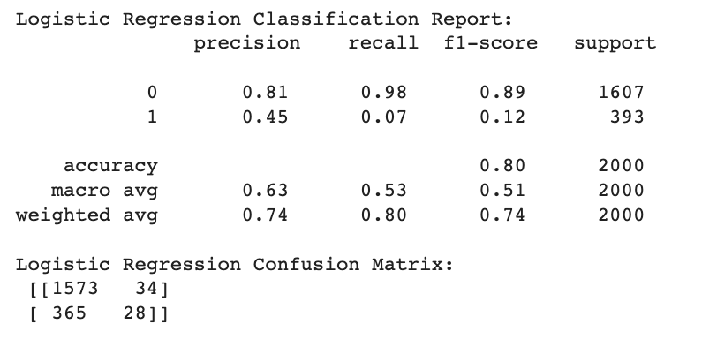
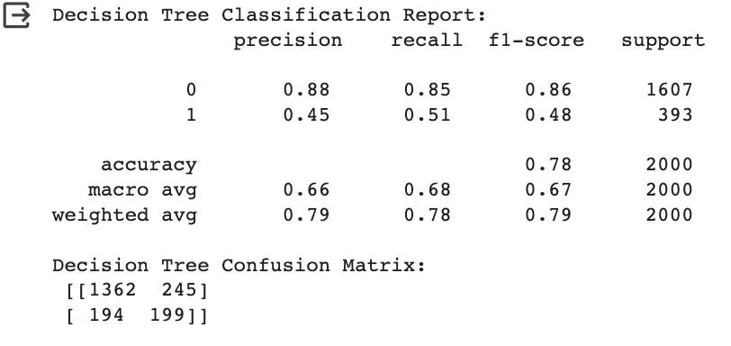
Classification report and Confusion Matrix

Slide 13
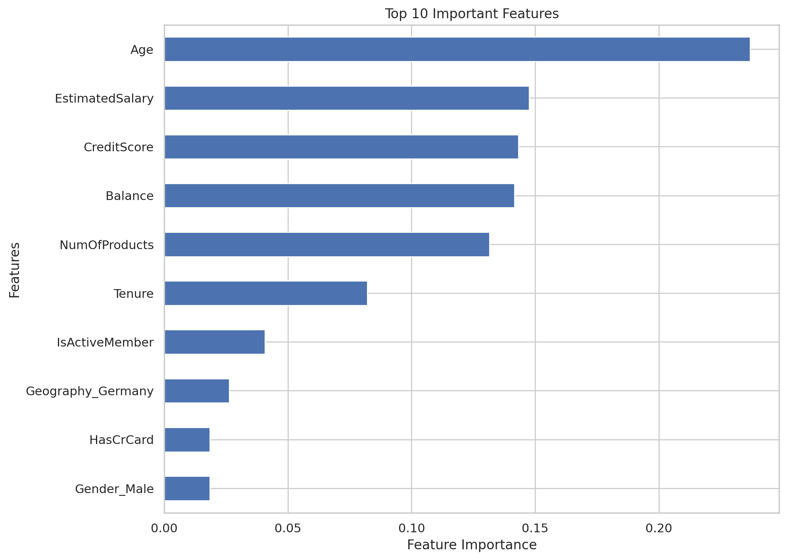
Top 10 important features determined by Random Forest

Slide 14
Conclusion
Key Findings and Recommendations:
Customers with higher balances and older age are more likely to churn.
Credit card ownership does not significantly affect churn rates.
Active membership is a strong predictor of lower churn rates.
Recommendations include targeted retention strategies for high-risk customer segments and personalized offers to engage inactive members.

